Slide 1
BANK MANAGEMENT SYSTEM
SUBMITTED BY:
GURDITYA KHURANA (RA1911003010572)
SNEHA GHOSH (RA1911003010630)

Slide 2
ABSTRACT
The bank management system project is a program that keeps track of a client’s bank account. This project demonstrates the operation of a banking account system and covers the essential functions of bank management software. It develops a project for resolving a customer’s financial applications in a banking environment to meet the needs of an end banking user by providing multiple ways to complete banking chores. Additionally, this project is to provide additional features to the user’s workspace that are not available in a traditional banking project.

Slide 3
INTRODUCTION
The Bank Management System (BMS) is a web-based tool that is used to reimburse financial institutions for services rendered to the Bureau of the Fiscal Service. In addition, BMS provides analytical tools for reviewing and approving salaries, budgets, and outflows.The bank management system is built on cutting-edge technologies. This project’s main goal is to create software for a bank account management system. This project was designed to make it simple and quick to complete previously impossible processes with manual systems which are now possible with this software.

Slide 4
DESCRIPTION
This project has been developed to carry out the processes easily and quickly, which is not possible with the manuals systems, which are overcome by this software.
Creating and managing requirements is a challenge of IT, systems and product development projects or indeed for any activity where you have to manage a contractual relationship. Organization need to effectively define and manage requirements to ensure they are meeting needs of the customer, while proving compliance and staying on the schedule and within budget. The impact of a poorly expressed requirement can bring a business out of compliance or even cause injury or death.

Slide 5
PROJECT OBJECTIVES
The goal of the bank management system project is to create an organic and optimal software of interaction between the various banking components. This is to maximize the profit of the banking mechanism. The implementation of competent bank management procedures is significantly responsible for the successful optimization of the bank’s productivity and activities.
The project’s main goal is to create an online banking system for banks. All banking work is done manually in the current system. To withdraw or deposit money, the user must go to the bank. Today, it is also hard to find account information for people who have accounts in the banking system.

Slide 6
Project Scope
Depending on the bank’s policies, bank personnel and/or customers can utilize the Banking Management System. It can be utilized by multiple employees at the same time if they have the necessary permissions. Any web browser with a graphical interface can be used to access it.

Slide 7
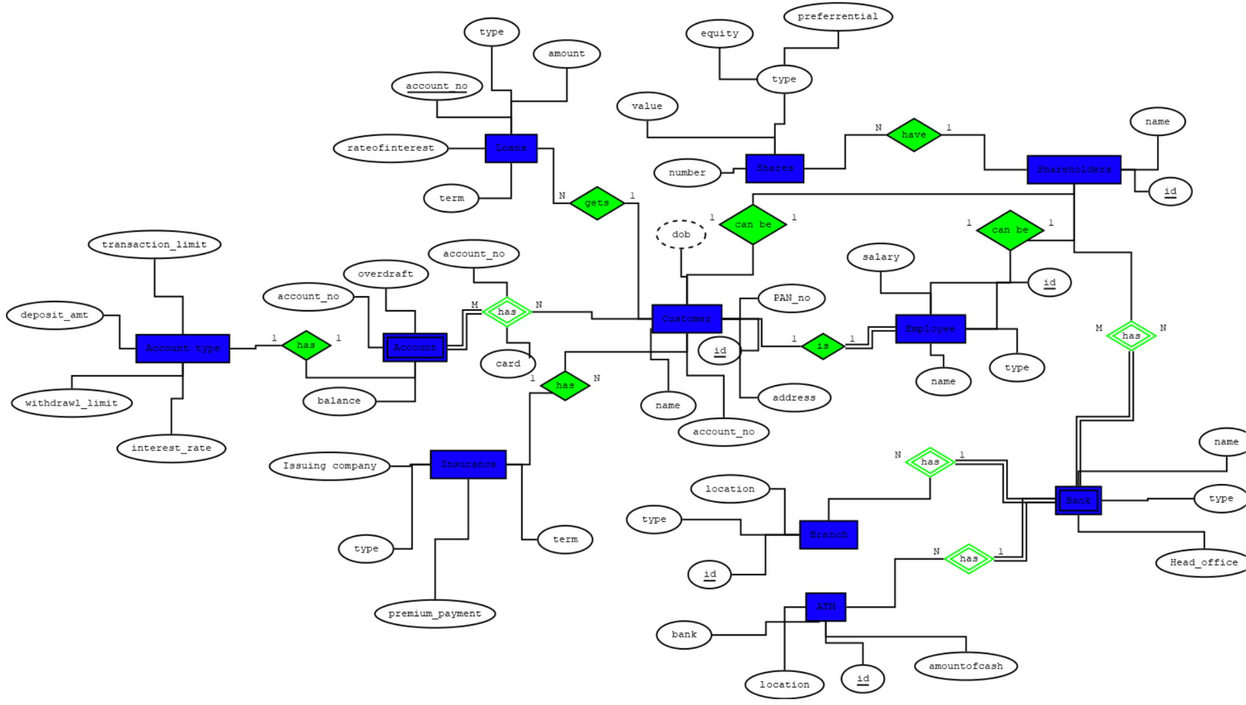
ER Diagram

Slide 8
Features
User can search details of the Accounts, Balance, Customer, Employees
Banking Management System is an online application, from which user can easily manage Balance details, Saving Account details, Current
Account details
Admin can track all the information of Balance, Accounts, Saving Account ect
Admin can edit, add, delete and update the records of Current Account, Customer, Employees
Manage the information about of Saving Account, Customer, Balance.

Slide 9
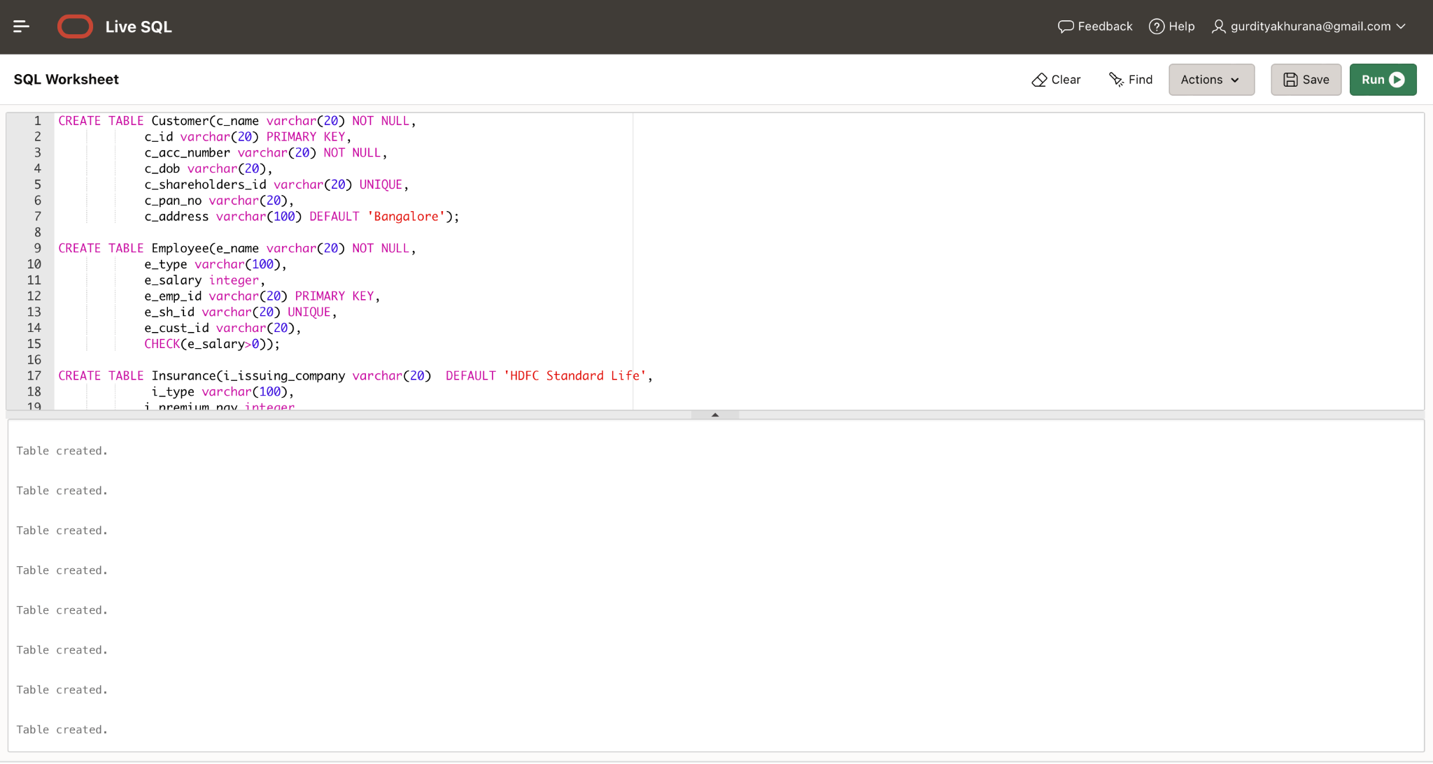
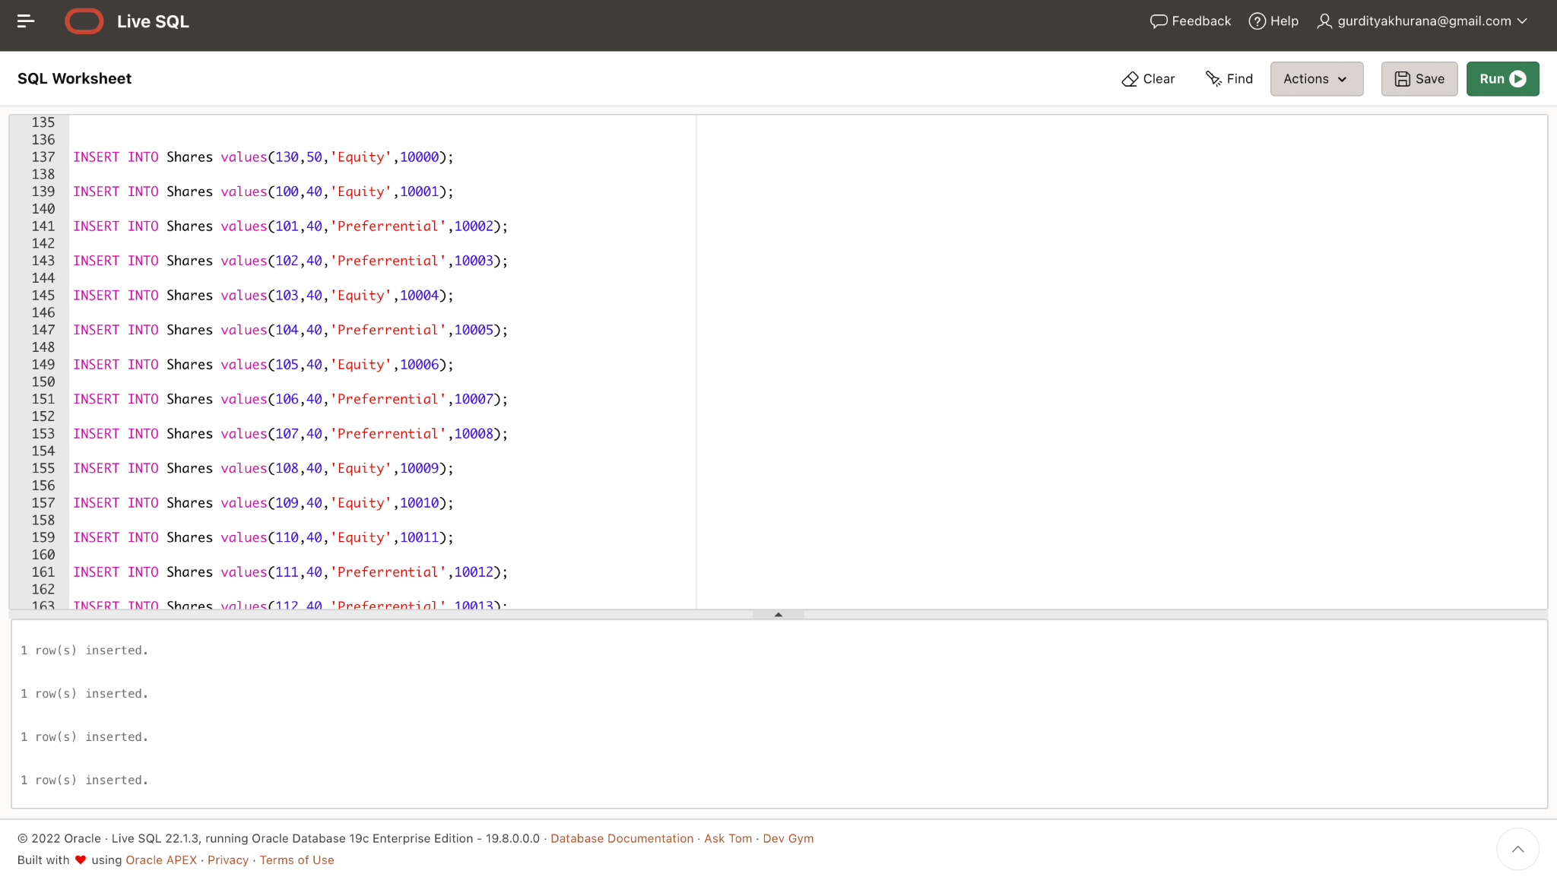

Slide 10
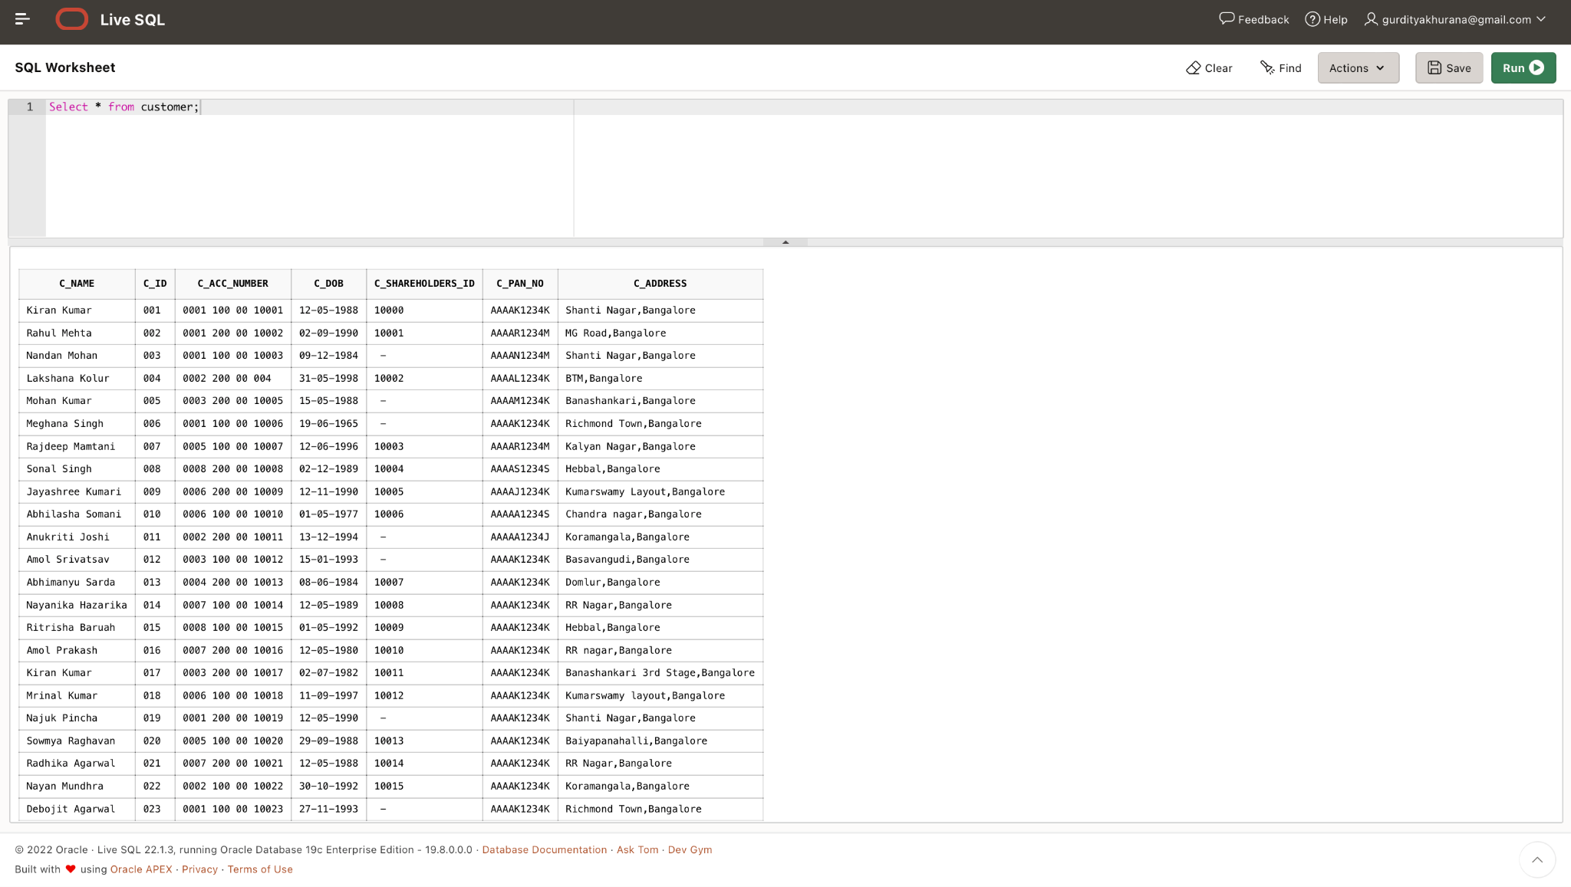
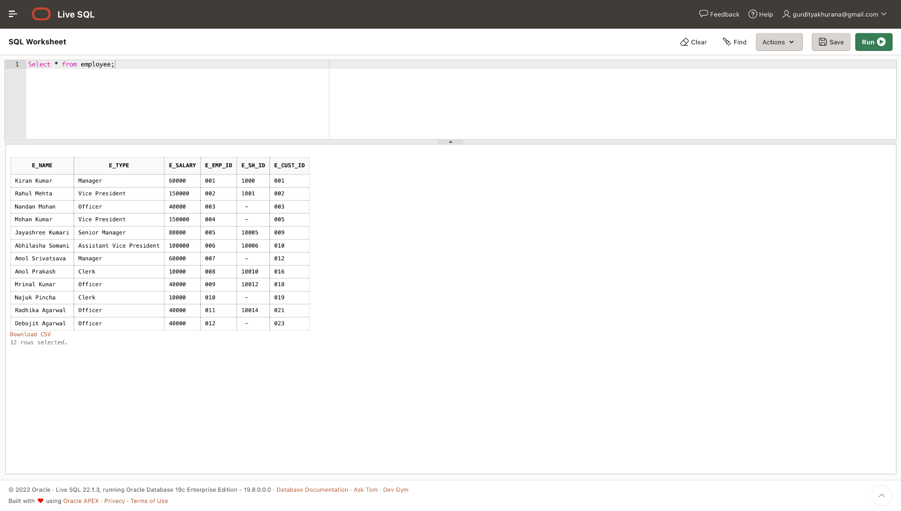

Slide 11
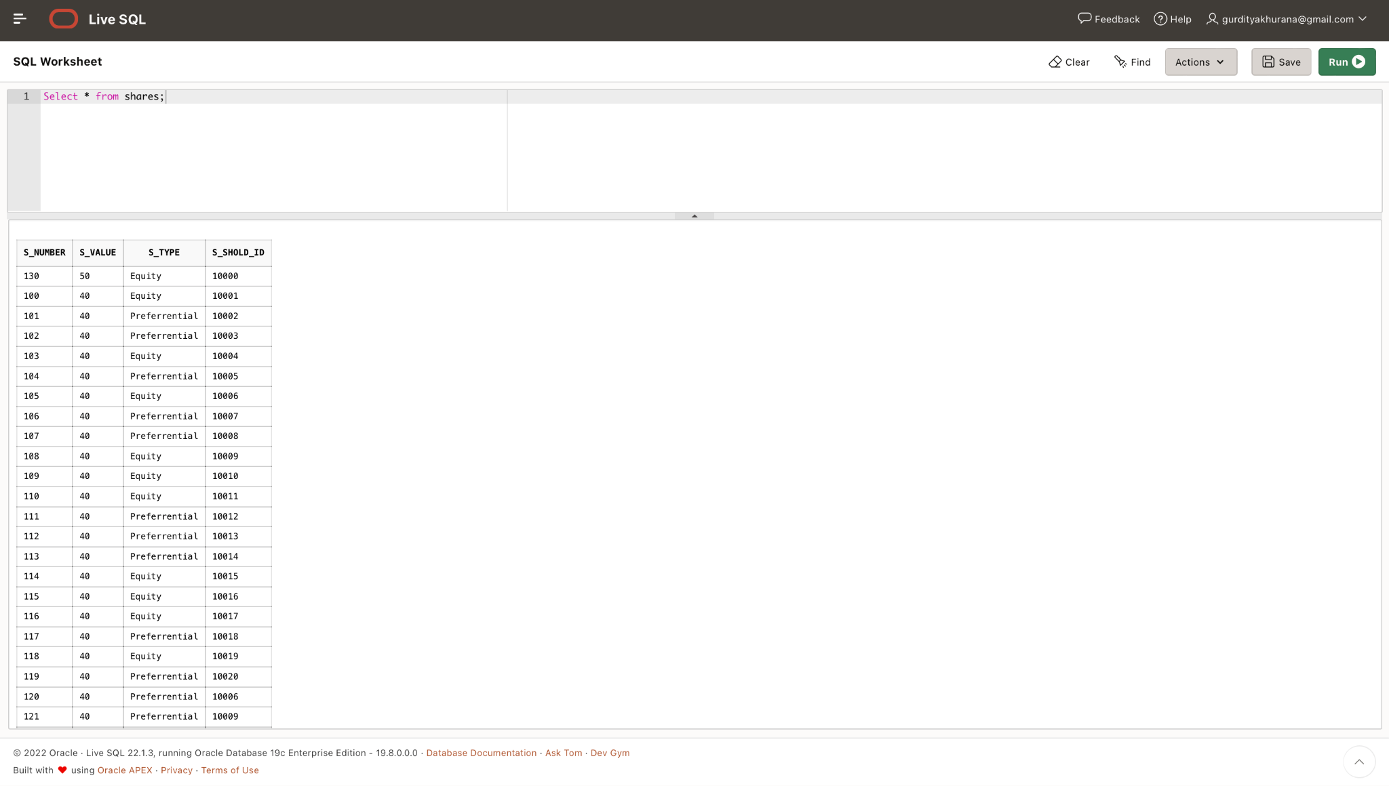
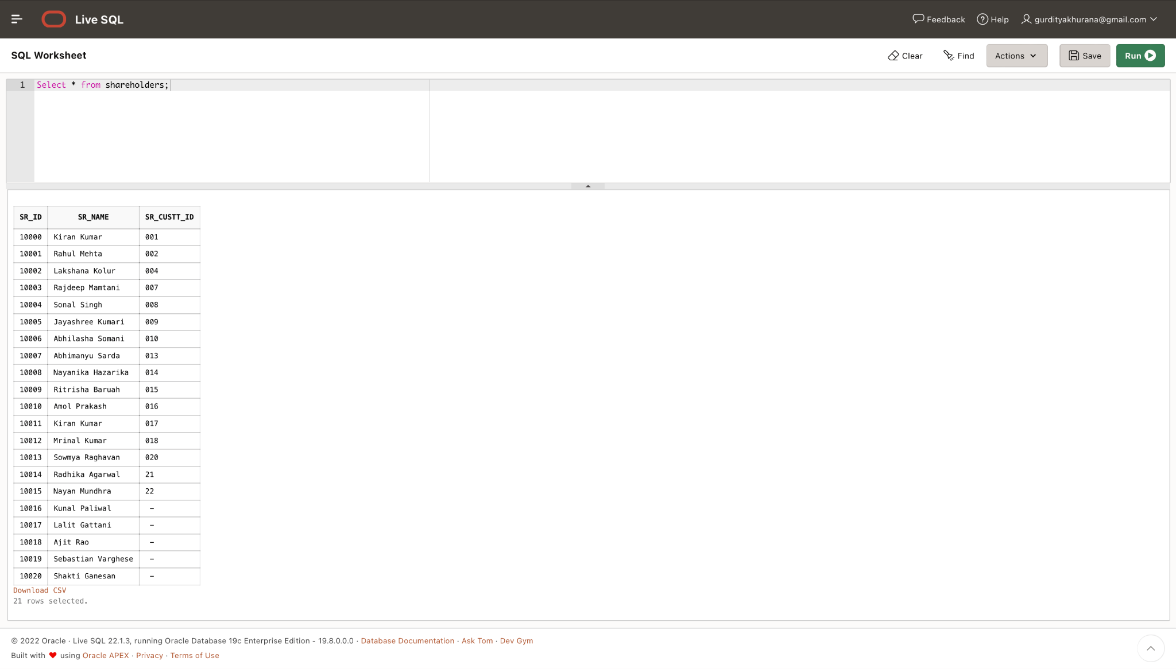

Slide 12
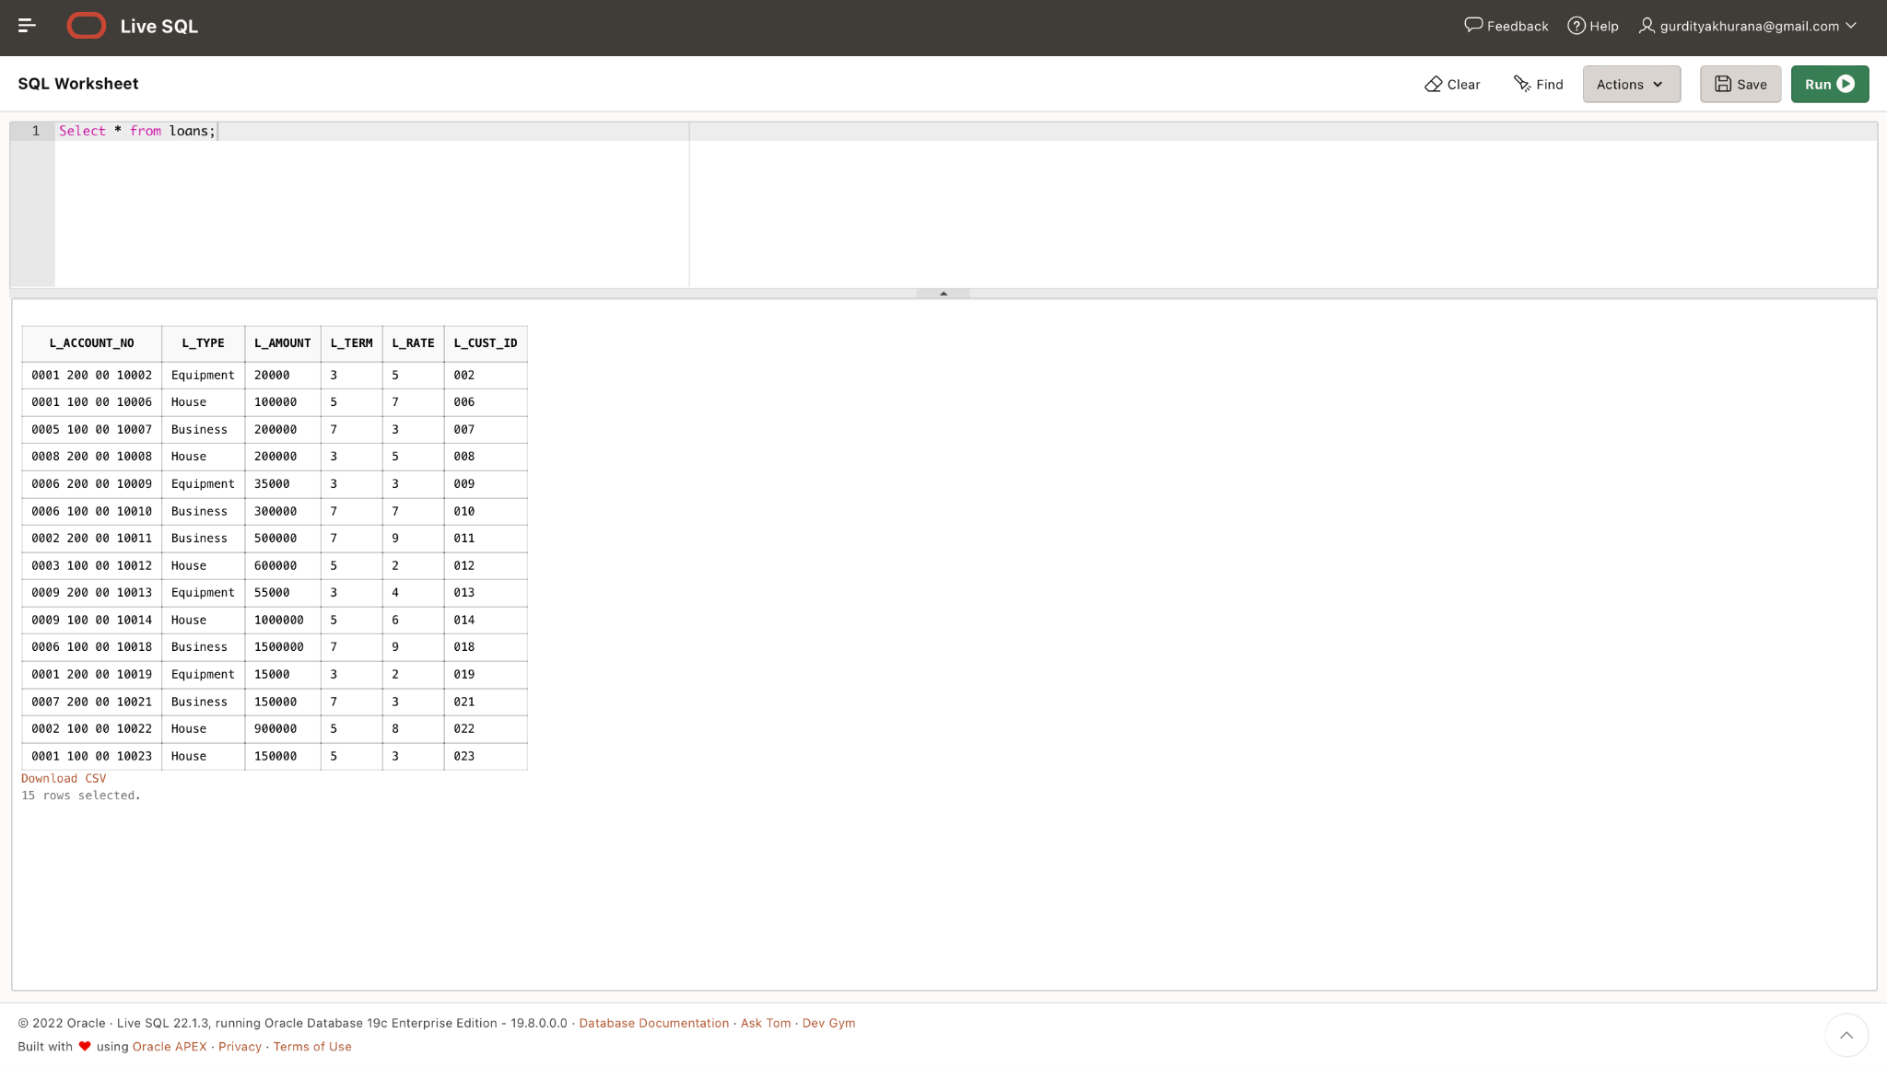
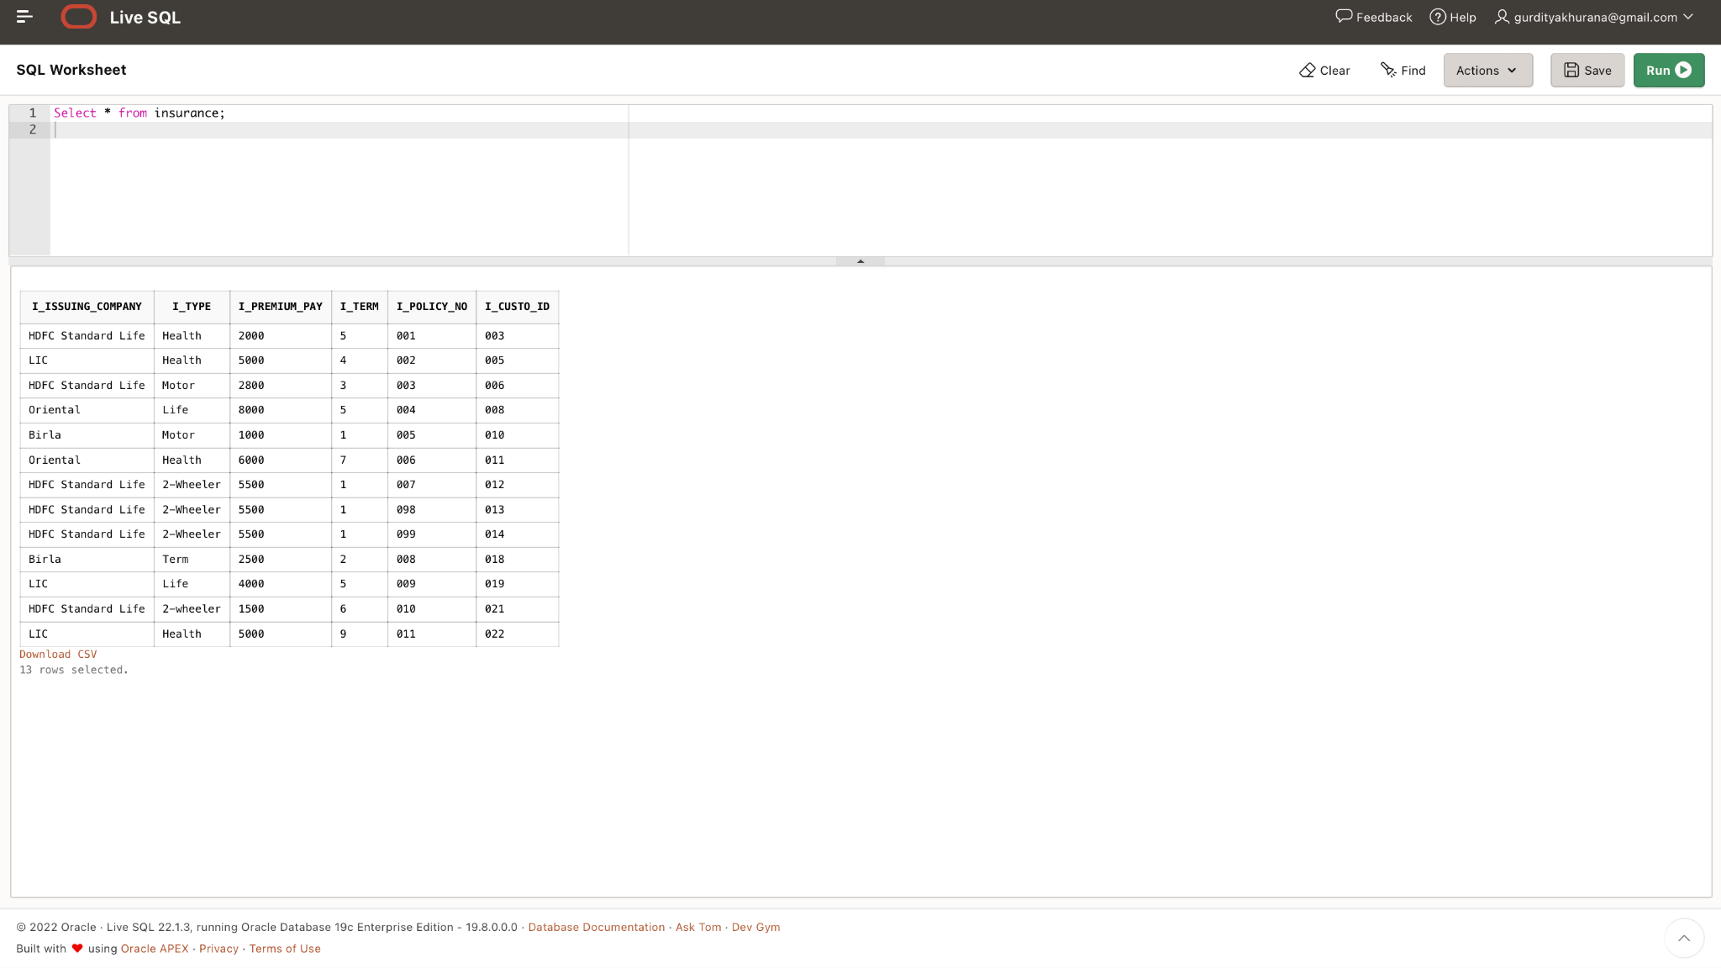

Slide 13
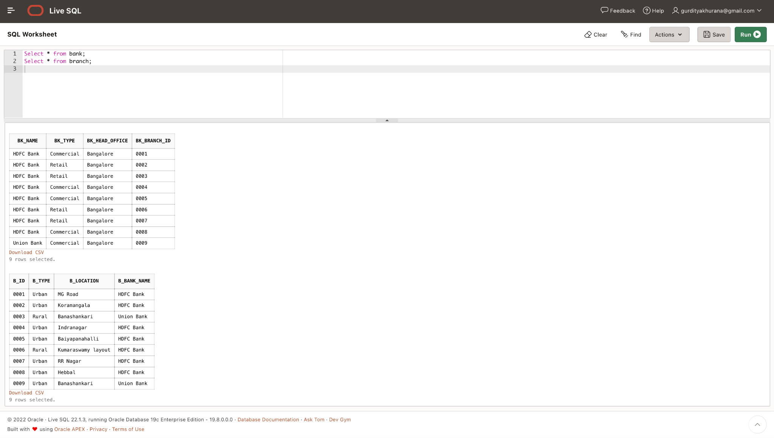
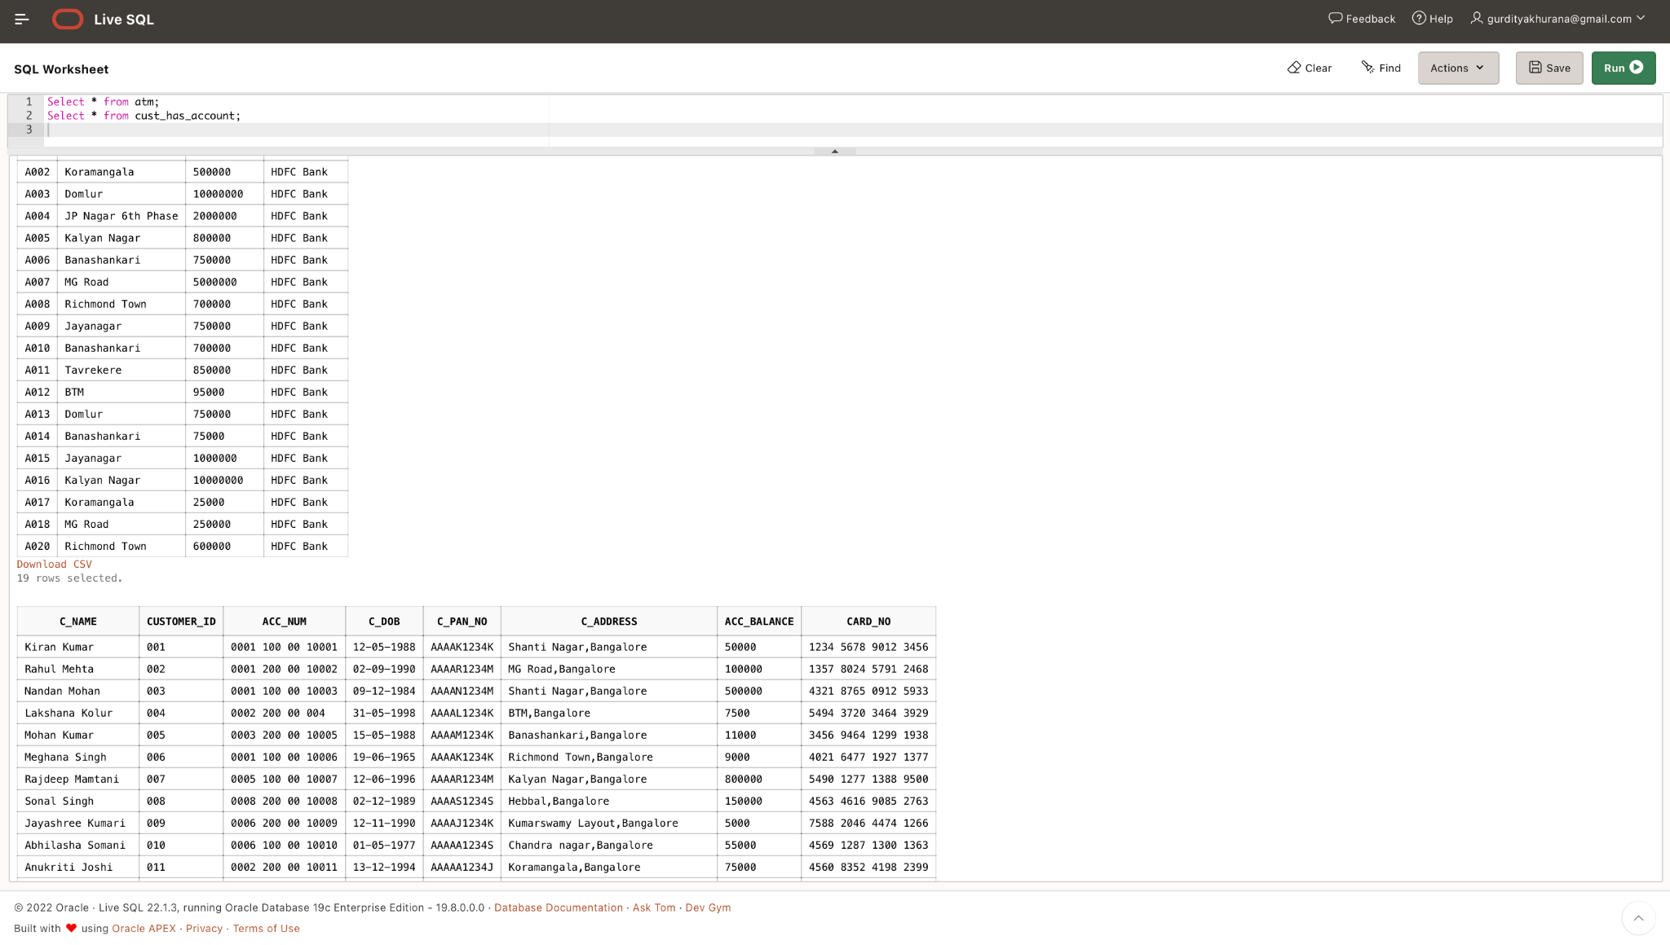

Slide 14
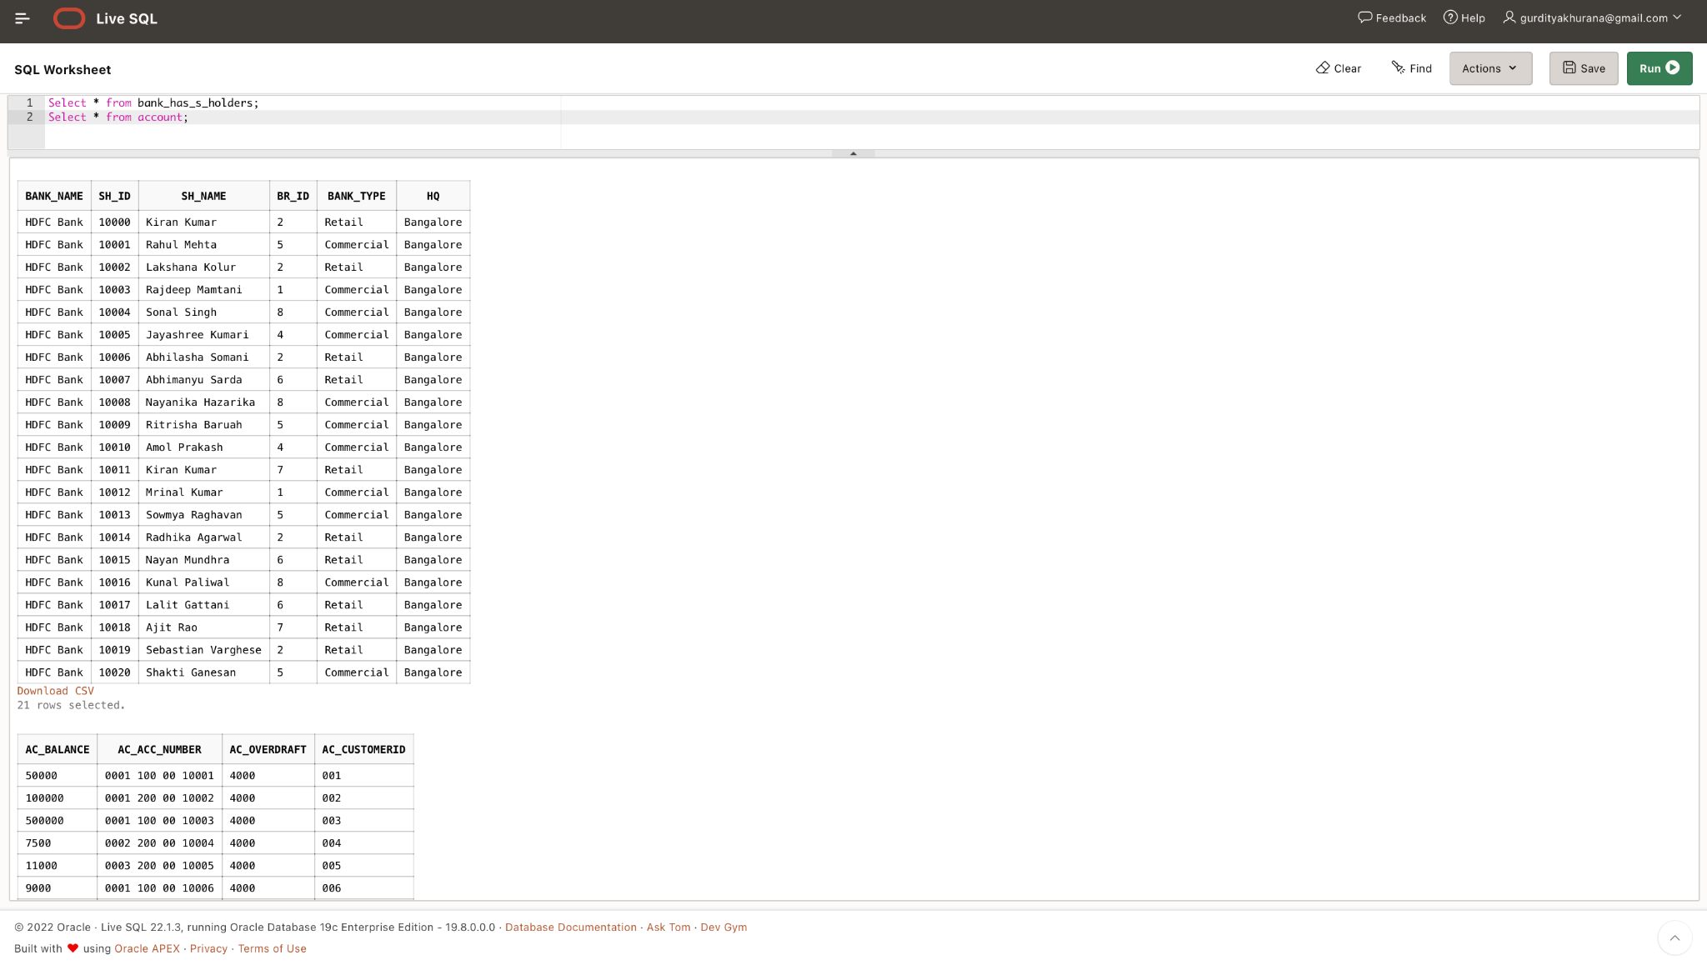

Slide 15
THANK YOU

